Slide 1
Retrieval Augmented Generation on JFK Assassination Records
Evan Dartez

Slide 2
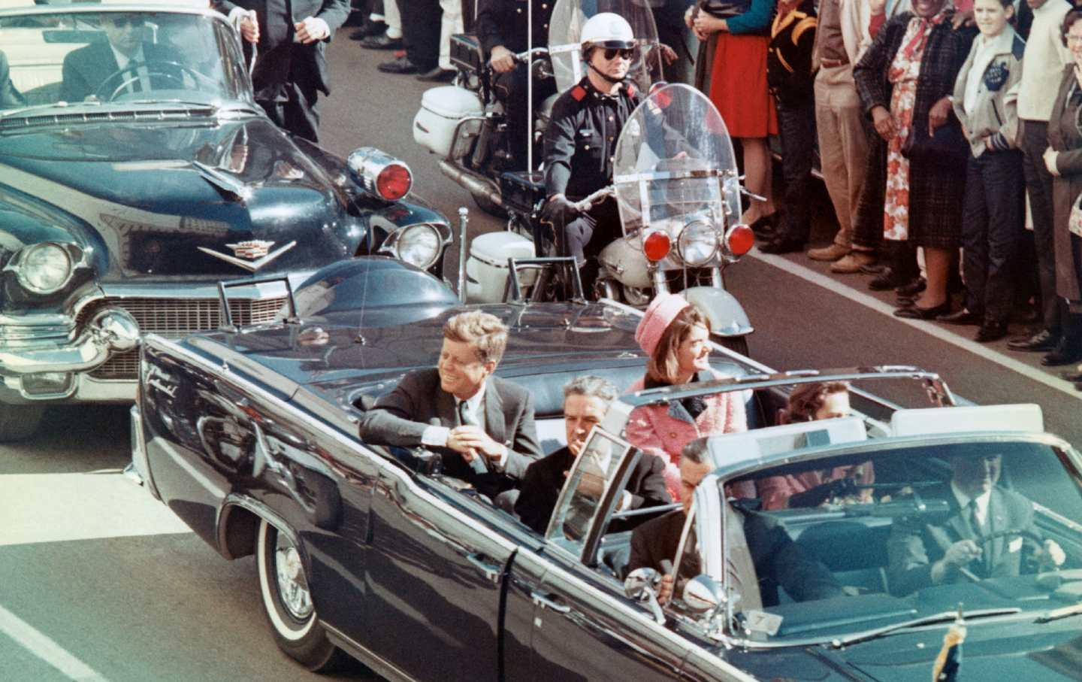
The Problem
There are over 700,000 pages of released JFK documents
Many are unstructured text, scanned images, or poorly organized.
Hard to extract any meaningful insight manually.
Goal: Use modern NLP to automate retrieval and answer questions from documents.

Slide 3
Pipeline
OCR to digitize scanned documents:
Tesseract for most docs
TrOCR for poor quality and handwritten docs
Text cleaning and correction:
BERT-based autocorrect with a reference Wikipedia dataset
Embeddings
Sentence transformers
Vector Search
FAISS
RAG

Slide 4
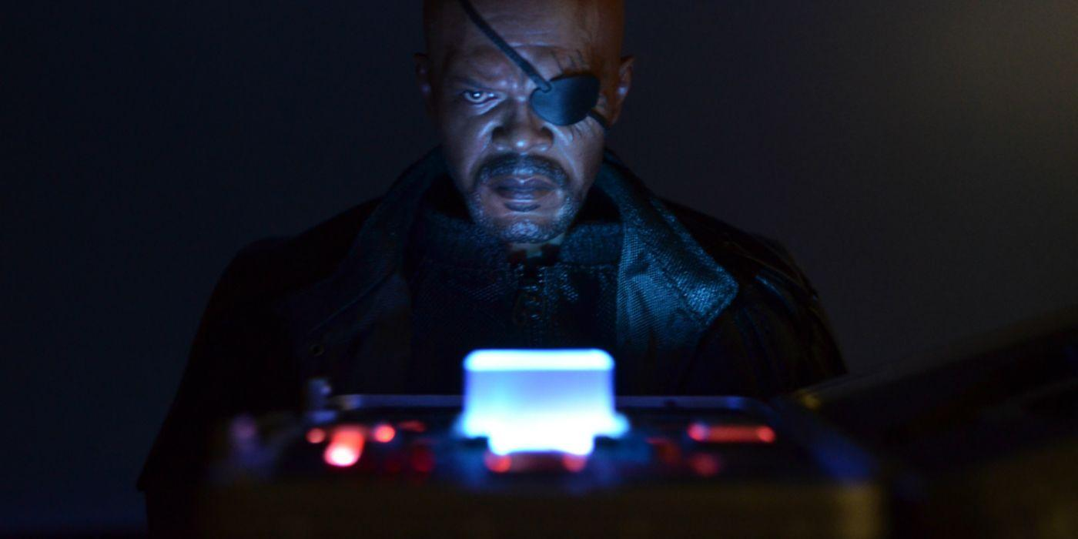
OCR System
Scanned PDF → Tesseract OCR → (if low quality) → TrOCR fallback → Token cleanup → NLP pipeline

Slide 5
Evaluation Metrics
Retrieval:
Recall @ k- How often correct doc chunk was in top k retrieved
Precision @ k- Ratio of relevant retrieved chunks to total retrieved chunks
Average Embedding Cos Similarity- measures how semantically aligned query is with retrieved chunks
Generation:
Answer Factuality- Are the answers correct and do they reflect the retrieved content:
ROUGE- Compare generated text to reference summaries

Slide 6
RAG DEMO
Use OCR text database that I have so far.
Search Across Document Corpus.
Summarize Answers with Falcon-7B
RAG System:
Question Input → FAISS Vector Search → Retrieve Relevant Chunks → Falcon 7B → Final Answer Output

Slide 7
Demo Questions
What does the Warren Commission conclude about Lee Harvey Oswald's motivations?
Was Lee Harvey Oswald connected to the Soviet Union or Cuba?
Did the FBI have a file on Oswald before the assassination?
What evidence did the Warren Commission present to show Oswald acted alone?
Did the Warren Commission find evidence of a conspiracy?
Was Jack Ruby involved in any conspiracy according to the Commission?
Did the Commission believe Cuba or the USSR were involved in JFK’s assassination?
What internal criticisms or doubts did Commission members express?

Slide 8
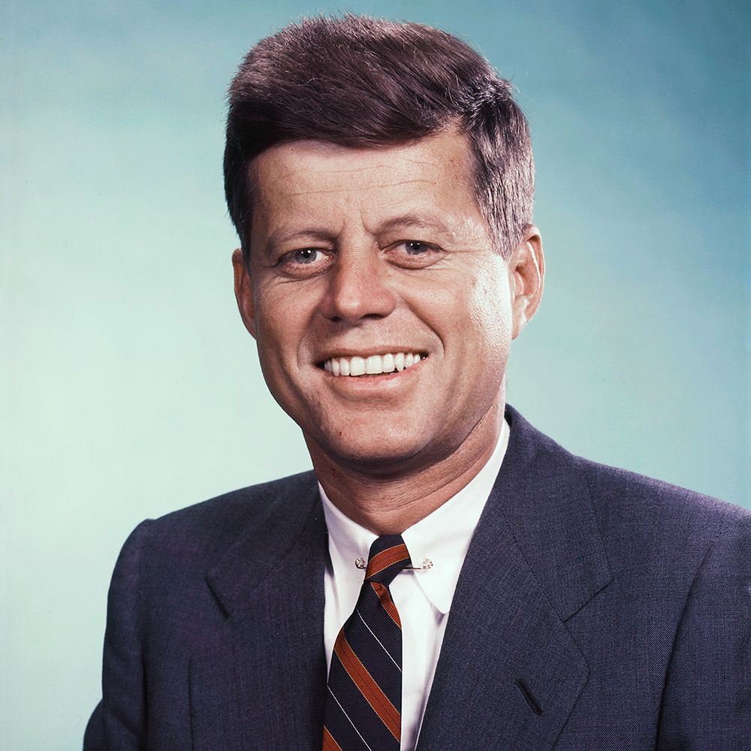
Questions

